Slide 1


Slide 2
TEAMMATES
Hussein Abumelih - Scrum Trainer
Danail Phurnika - Developer Front-End
Kaloyan Yordanov - Developer Front-End
Alexander Photev - Designer
Dani Gramatikov - Developer Back-End
Daniel Kolev - Developer Back-End

Slide 3
Contents
1.Topic
2.Summary
Goal
Main stages in accomplishment of the project:
Planning
Realization
4.Going through the code
Time management
3.Main problems during realization
Working with files

Slide 4

Summary
This Photo by Unknown author is licensed under CC BY-SA.

Slide 5

Goal
Goal - our goal was to create a informational website and application with up-to-date information about aquatic resources and animals and etc.

Slide 6
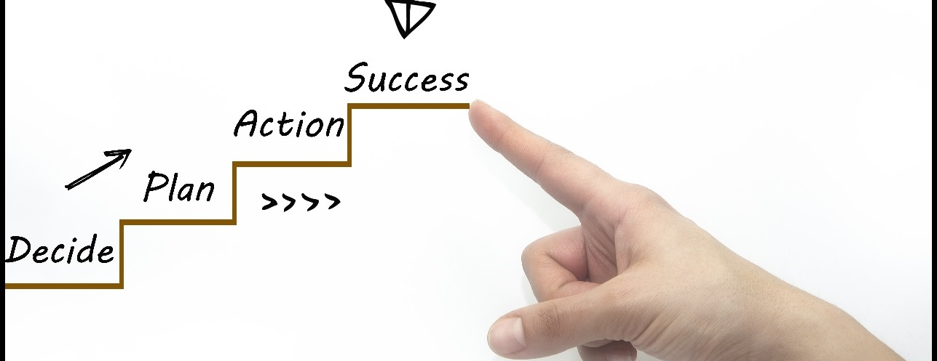
Main stages in accomplishment of the project

Slide 7

Difficulties during realisation

Slide 8
Going through the project

Slide 9
THANK YOU FOR YOUR ATTENTION!

